Slide 1
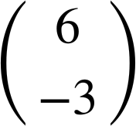
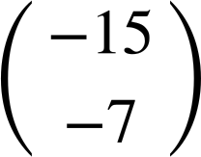
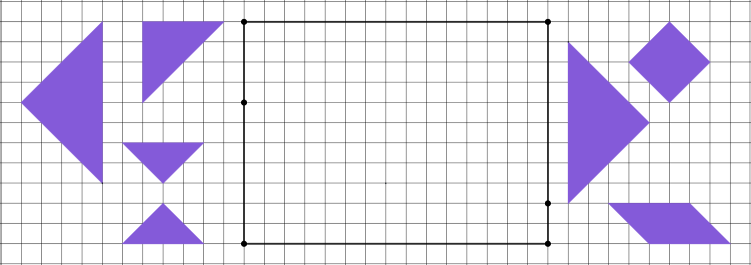
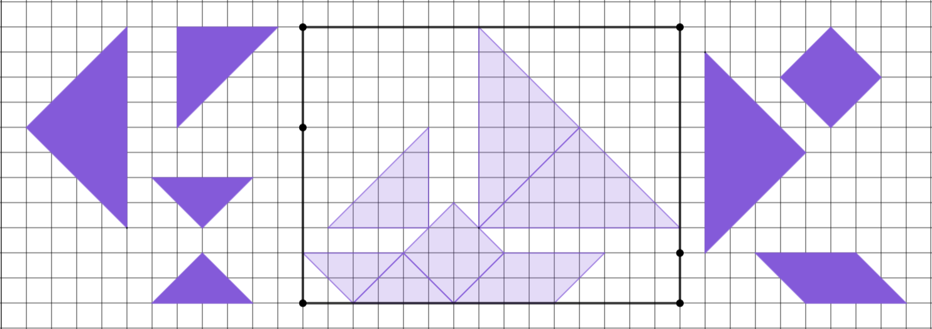
Checking understanding of congruence
Task A: Transformations with congruence
1)
a) Reflect A over PT.
b) Rotate B 180° around U.
c) Translate C .
d) Reflect D over PT.
e) Translate E .
f) Rotate F 90° anticlockwise around R.
g) Reflect G over QS
P
Q
B
E
A
U
F
C
R
G
D
T
S

Slide 2
Checking understanding of congruence
Task B: Identifying missing information on congruent shapes
1) The five triangles are congruent.
4
37°
37°
a) What transformation maps A onto B?
3
B
rotation
4
5
53°
5
A
b) What transformation maps B onto C?
reflection
53°
53°
5
3
3
C
c) What transformation maps C onto D?
37°
translation
4
5
53°
53°
5
d) What transformation maps D onto E?
3
3
D
reflection
37°
E
37°
4
4
e) What transformation maps E onto A?
rotation
f) Label the missing lengths and angles on triangles B to E.
2) The four quadrilaterals are congruent. The transformations which map each shape onto the next shape are stated below.
2.99
2.99
2.99
3
89°
92°
89°
92°
92°
89°
88°
91°
3.99
A
4
3.99
B
4
4
C
3.99
3.99
D
4
88°
91°
88°
91°
91°
88°
89°
92°
3
3
3
2.99
A ↦ B: translation
B ↦ C: reflection
C ↦ D: rotation of 180°
a) Label the missing lengths and angles on shapes B to D.
b) Which transformation could be applied to shape D to create an image that is in the same orientation as shape A?
reflection (over a horizontal line)
Mathematics in Education and Industry
v2.3

